Slide 1
Science Understanding
Human Variation
DNA Technology

Slide 2

Study Guide
Read:
Our Human Species (3rd edtn)
Chapter 18, section 10
Complete:
Human Biological Science Workbook
Topic 17 – Biotechnology

Slide 3
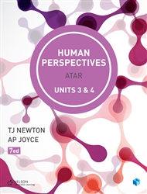
Further information
Write down the chapter and page numbers in HP that cover this topic:
Ch: __________________
Pages: _______________

Slide 4
Unit 3 SHE
synthetic hormones may be developed to control or treat endocrine dysfunction, including diabetes mellitus, hypothyroidism and hyperthyroidism, to improve the quality of life for individuals
gene therapy can be used to treat a range of diseases, including diabetes mellitus
hormones and vaccines are developed using recombinant DNA and associated biotechnological techniques

Slide 5
Unit 4 Evolution
biotechnological techniques provide evidence for evolution by using PCR (to amplify minute samples of DNA to testable amounts), bacterial enzymes and gel electrophoresis to facilitate DNA sequencing of genomes

Slide 6
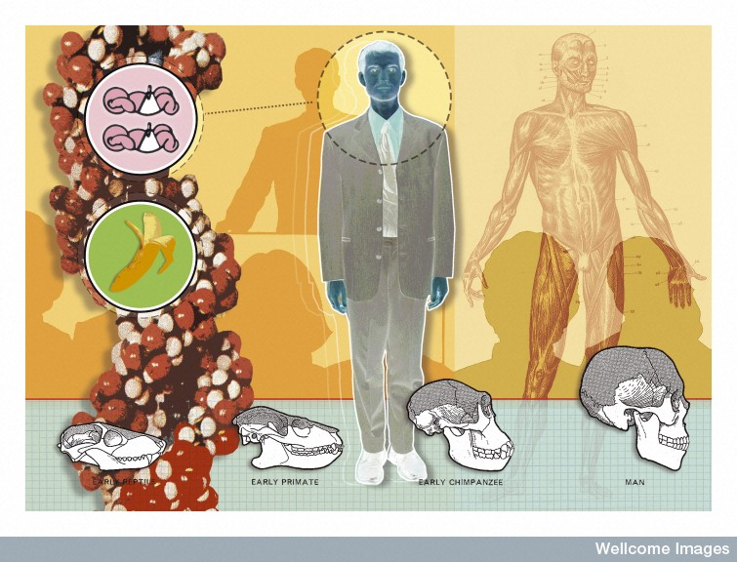
Every individual’s DNA is inherited from his or her parents, and is unique
M Herring, Wellcome Images

Slide 7
DNA profiling
Everyone’s DNA is unique (except for identical twins), half being inherited from the mother and half from the father.
The unique nature of DNA provides the basis for DNA profiling - also known as DNA fingerprinting.

Slide 8
Applications
DNA profiling can be used for establishing an individual’s identity (e.g. that of a corpse or in crime investigations), or determining their parentage. It is also used in anthropological research and for detecting genetic variations and/or mutations that may play a role in the development or progression of a disease.

Slide 9
Creating a DNA profile
A DNA profile can be created from a very tiny sample of DNA (e.g. from the saliva or a fingerprint on a glass). A profile can even be established from very old or damaged DNA.
From a single sample many copies can be produced using a technique called the polymerase chain reaction (PCR).

Slide 10
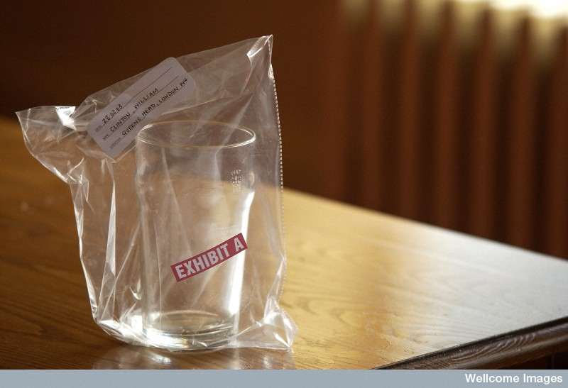
DNA forensic evidence
Wellcome Library, London

Slide 11
There are many differences in the DNA of different people and it is not practical to look at all of them.
Usually, ten key differences are studied. These DNA sequences are known to vary widely between individuals.

Slide 12
STRs
A DNA profile usually examines ten repeat base sequences, known as short tandem repeats (STRs). These DNA sequences occur on different chromosomes.
STRs occur in non-coding sections of the DNA – for example you might find the sequence CCTG repeated several times in one particular section of DNA on one chromosome.

Slide 13
A person might inherit six repeats on their mother’s chromosome and eight repeats on the matching chromosome from their father.
When the ten STRs are analysed it is highly unlikely that anyone else will share the same pattern of repeats.

Slide 14
Electrophoresis
The number of repeats determine the length of the DNA within an STR.
The DNA can be chopped up and the STRs isolated using special enzymes.
The pieces of DNA are sorted according to size using electrophoresis.

Slide 15
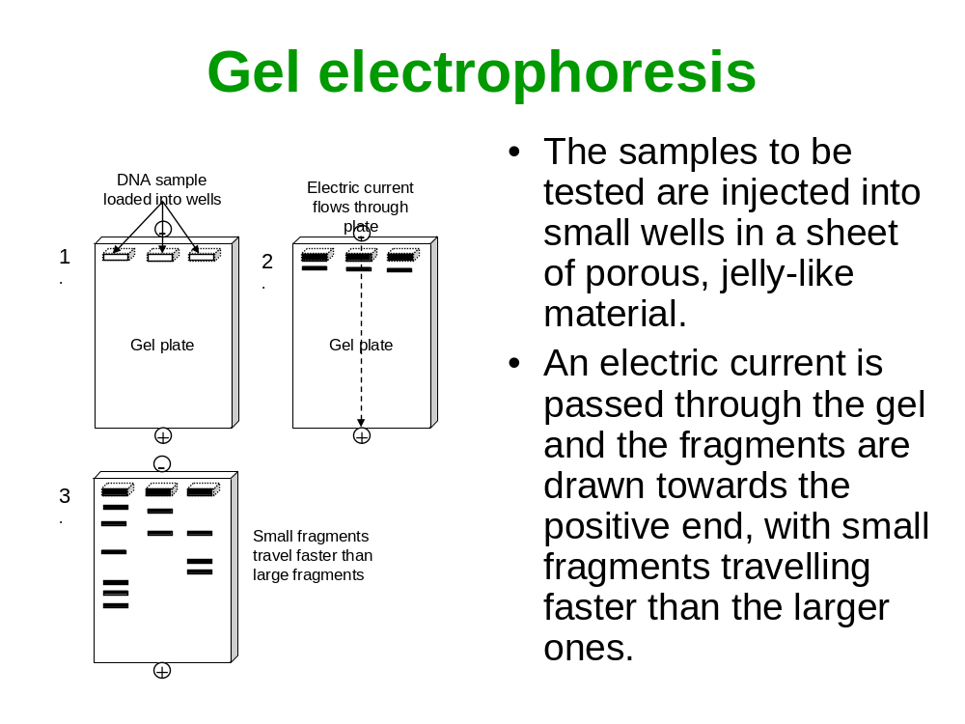

Slide 16
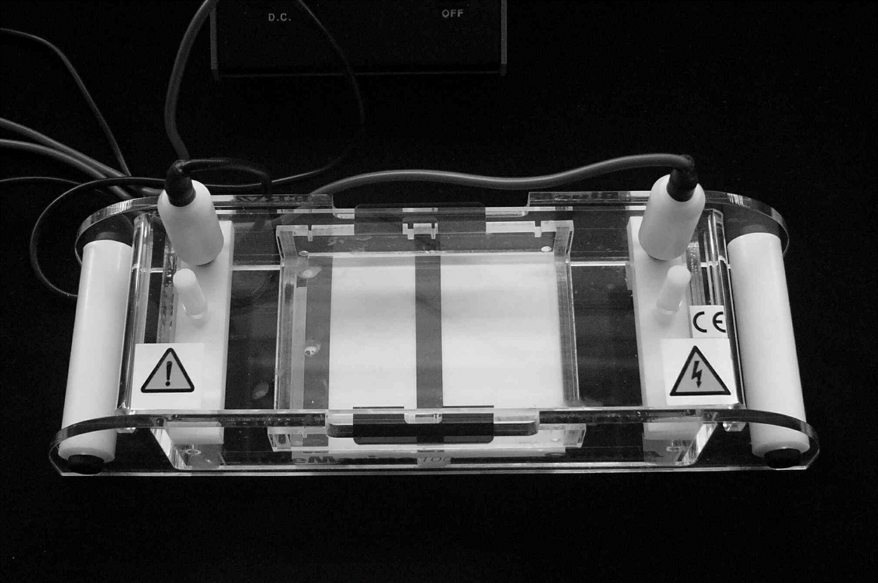
An electrophoresis cell

Slide 17
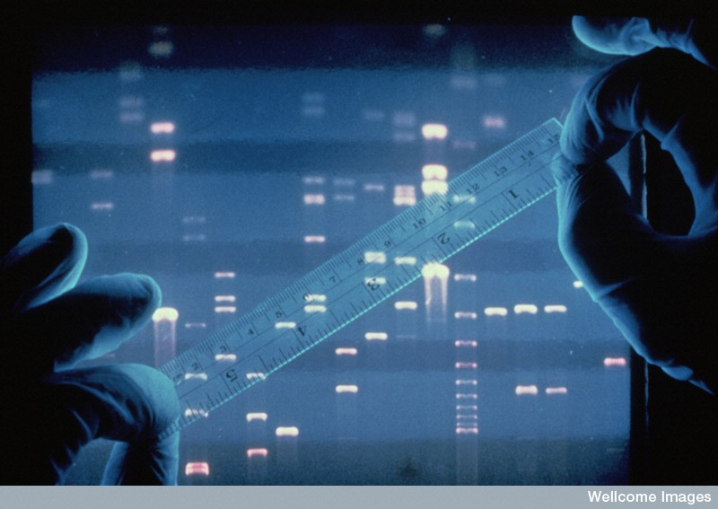
DNA profiling using gel electrophoresis
Each white band represents a segment of DNA.
The smaller fragments travel through the gel faster (and therefore further) than the heavier ones.
Wellcome Photo Library

Slide 18
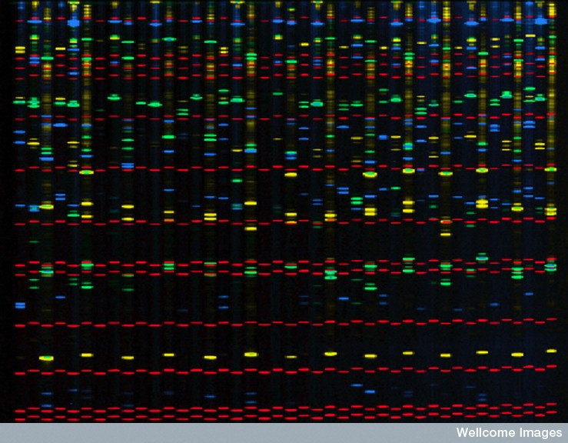
Comparitive DNA profiles of 14 unrelated people
Susan Moberly, Wellcome Images

Slide 19
The above slide shows the DNA profiles of fourteen unrelated individuals.
The green, blue and yellow bands show some similarities and some differences between individuals.
The positions of the bands show the variation in the lengths of different STRs.
The red bands are size markers.

Slide 20
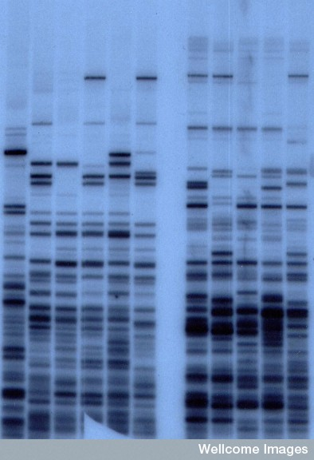
DNA patterns from a mother and her four children
DNA patterns from a mother (lanes 2 and 8) and her four children (adjacent lanes to the right). Lane 1 is an unrelated person.
A Jeffreys, Wellcome Images

Slide 21
DNA profiling can be used for detecting genetic variations and/or mutations that may play a role in the development or progression of a disease.

Slide 22
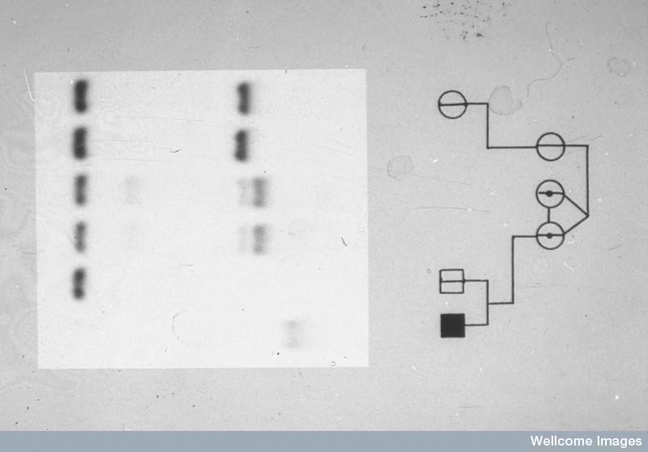
Detecting the fragile X chromosome
Repeats of the base sequence CGG are characteristic of this chromosome
Wessex Reg Genetics Centre, Wellcome Images

Slide 23
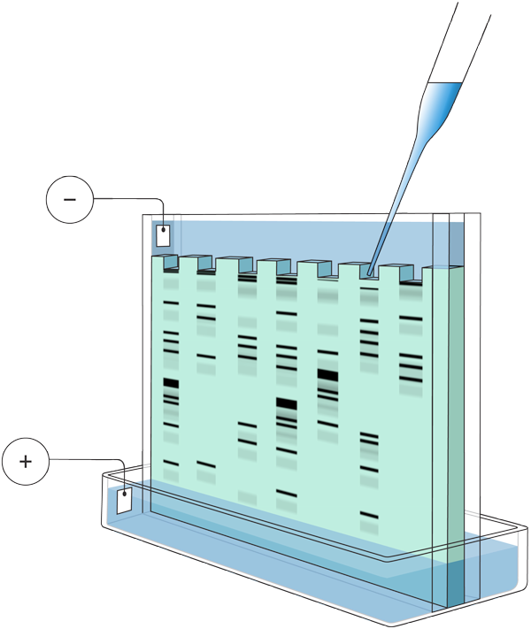
Gel Electrophoresis
Gel electrophoresis can be used to separate large molecules (including nucleic acids or proteins) on the basis of their size, electric charge, and other physical properties.
  To prepare DNA for electrophoresis, the DNA is often cut up into smaller pieces. Called a restriction digest, and it produces a range of DNA of different lengths.
  To carry out electrophoresis, the DNA samples are placed in wells and covered with a buffer solution that gradually dissolves them into solution.
Wells into which samples to be analysed are placed.
Sample
Cathode
Buffer
Plastic frame
Anode
Gel
DNA fragments, shown symbolically above, move towards the positive terminal (smaller fragments move faster than longer ones).
Buffer solution

Slide 24
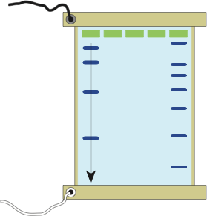
Running the Gel
-ve terminal
By applying an electric field to the solution, the molecules move towards one or other electrode depending on the charge on the molecule itself. DNA is negatively charged because the phosphates have a negative charge.
Molecules of different sizes (molecular weights) become separated (spread out) on the gel surface.
These can be visualised as bands by applying dyes or radio-labelled probes.
Wells: Holes created in the gel with a comb.
DNA solutions: Mixtures of different sizes of DNA fragments are loaded into each well.
Large fragments
DNA markers:
A mixture of DNA molecules with known molecular weights. They are used to estimate the sizes of the DNA fragments in the sample lanes.
DNA fragments: The gel matrix acts as a sieve for the DNA molecules.
Small fragments
+ve terminal
Tray: Contains the set gel.

Slide 25
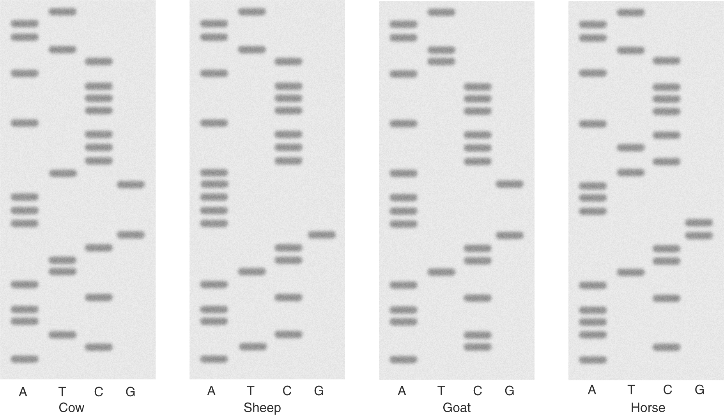
Interpreting Electrophoresis Gels
The banding pattern on an electrophoresis gel can give information about genetic variation and relationships.
Once run, an electrophoresis gel must be interpreted. If a specific DNA base sequence was being investigated, then the band pattern can be used to determine the DNA sequence and the protein that it encoded.
Alternatively, depending on how the original DNA was treated, the banding pattern may be used as a profile for a species or individual.
Commonly, the gene for cytochrome oxidase I (COXI), a mitochondrial protein, is used to distinguish animal species.

Slide 26
DNA sequencing
DNA sequencing is the determination of the exact order of the base pairs in a segment of DNA.

Slide 27
Polymerase chain reaction
The polymerase chain reaction (PCR) is like a biological photocopier. It is used for creating multiple copies of a specific section of DNA from a sample (DNA amplification).
PCR is useful when only small amounts of DNA are available for analysis.

Slide 28
Denaturing
The three steps in PCR are :
  denaturing
  hybridisation
  synthesis
Denaturing involves heating the DNA to separates the two strands.

Slide 29
Hybridisation
Primers (short synthetic RNA fragments) are added to the DNA.
The primers bind to complimentary base sequences on the separated DNA strands.
The primers act as starting points for the replication of new DNA molecules.

Slide 30
DNA synthesis
DNA polymerase is added.
Starting at the primer, the DNA polymerase reads the DNA code and builds a complementary strand of DNA.
Each cycle takes 3-5 minutes.

Slide 31
Polymerase chain reaction
Target gene
5’
3’
3’
5’
PCR cycle 0
1 copy of gene
HEAT
5’
3’
5’
5’
3’
5’
PRIMER
EXTENSION
PCR cycle 1
2 copies of gene
DNA polymerase
Primer A
Primer B

Slide 32
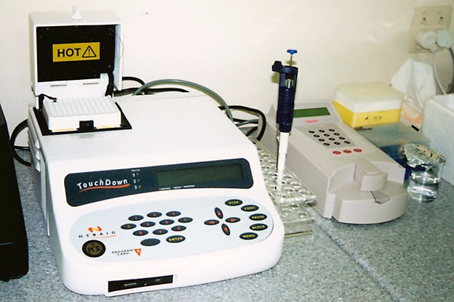
PCR Equipment
Amplification of DNA can be carried out with using PCR machines called thermal cyclers (shown below).
  Thermal cyclers are commonly used in the biological research institutes and analytical laboratories.

Slide 33
Steps in the PCR Process
1
Separate strands
Separate the target DNA strands by heating at 98°C for 5 minutes
The process called the polymerase chain reaction or PCR involves the following steps 1-3 each cycle:
2
Add reaction mix
Add primers (short nucleotide strands that provide a starting sequence for DNA replication), nucleotides (A, T, G and C) and DNA polymerase enzyme.
Repeat for about 25 cycles
Repeat cycle of heating and cooling until enough copies of the target DNA have been produced.
3
Incubate
Cool to 60°C and incubate for a few minutes. During this time, primers attach to single-stranded DNA.
DNA polymerase synthesises complementary strands.

Slide 34


Polymerase Chain Reaction
PCR cycles | No. of target DNA strands
1 | 2
2 | 4
3 | 8
4 | 16
5 | 32
6 | 64
7 | 128
8 | 256
9 | 512
10 | 1024
11 | 2048
12 | 4096
13 | 8192
14 | 16,384
15 | 32,768
16 | 65,536
17 | 131,072
18 | 262,144
19 | 524,288
20 | 1,048,576
21 | 2,097,152
22 | 4,194,304
23 | 8,388,608
24 | 16,777,216
25 | 33,554,432
Although only three cycles of replication are shown here, following cycles replicate DNA at an exponential rate and can make millions of copies in only a few hours.
  The process of PCR is detailed in the following slide sequence of
  steps 1-5.
Original DNA
Sample
Cycle 1
Cycle 2
Cycle 3

Slide 35
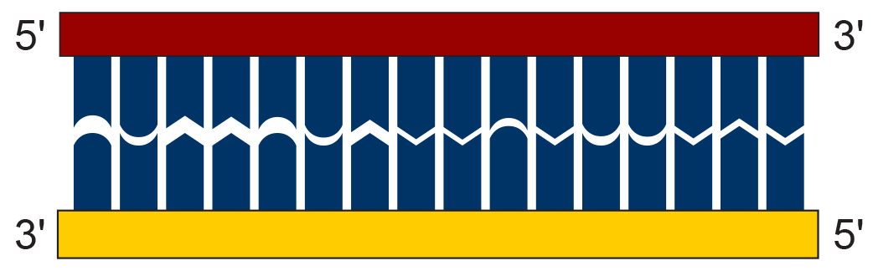

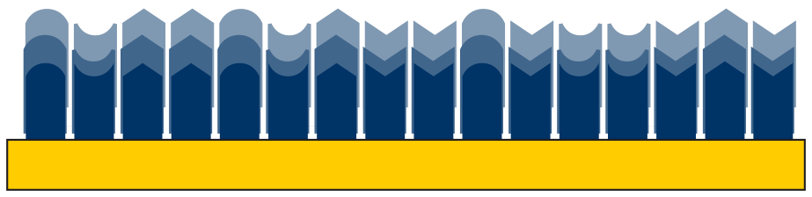
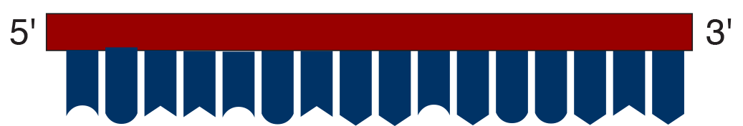
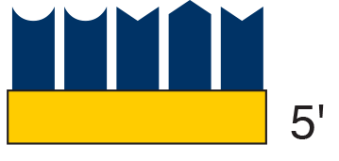

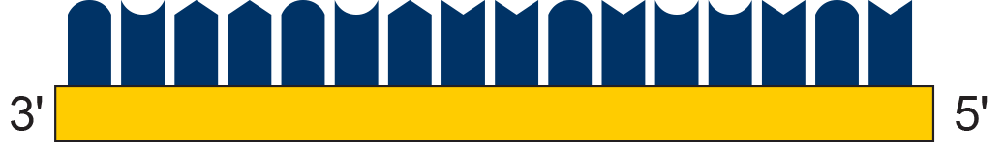
The Process of PCR
1
A DNA sample called the target DNA is obtained.
2
DNA is denatured (DNA strands are separated) by heating the sample for 5 minutes at 98ºC.
3
Primers (short strands of nucleotides) are annealed (bonded) to the DNA.
Primer moving into position
Primer annealed

Slide 36










The Process of PCR
Nucleotides
4
The sample is cooled to 60°C. A thermally stable DNA polymerase enzyme binds to the primers on each side of the exposed DNA strand.
This enzyme synthesises a complementary strand of DNA using free nucleotides.
Direction of synthesis
Direction of synthesis
Nucleotides
5
After one cycle, there are now two copies of the original sample.

Slide 37
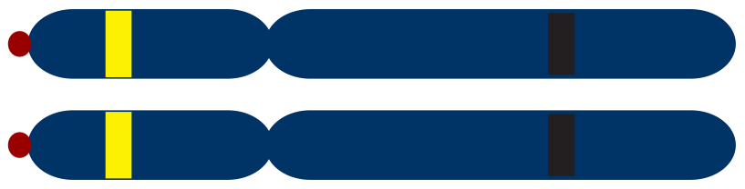
DNA Profiling Using PCR
Microsatellites or short tandem repeats (STRs) are found throughout the genome within genes and between genes, particularly near telomeres and centromeres.
  Microsatellites consist of a
  variable number of tandem
  repeats of a 2 to 6 base pair
  sequence. In the example
  shown it is a two base sequence
  (CA) that is repeated.
  The human genome contains
  about 100,000 separate blocks
  of tandem repeats of the
  dinucleotide: CA. One such
  block at a known location on
  a chromosome is shown in the
  diagram opposite.
Microsatellite containing 4 repeat units
Homologous pair of chromosomes
telomeres
centromeres
Microsatellite containing 7 repeat units
Flanking regions to which PCR primers can be attached

Slide 38
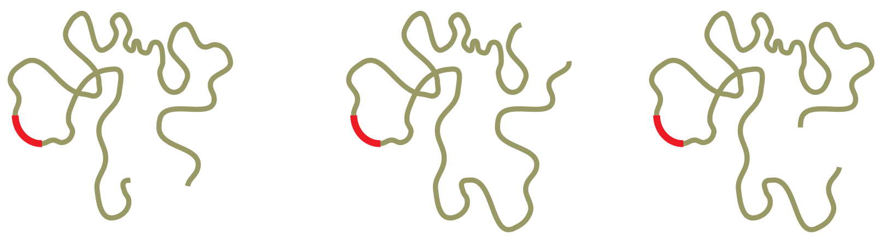
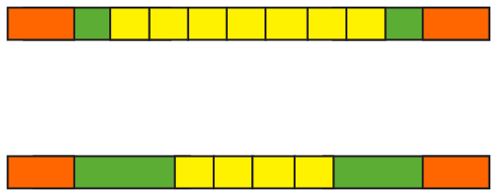
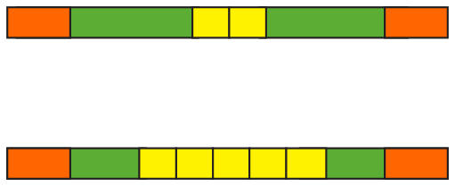
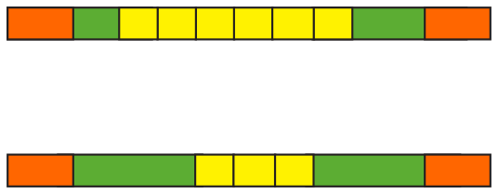
STRs Used in DNA Profiling
1
Extract DNA from sample
A sample is collected from the tissue of three individuals from which the DNA is extracted, separated and purified.
DNA from
individual ‘A’:
DNA from
individual ‘B’:
DNA from
individual ‘C’:
Microsatellite
2
Amplify microsatellite using PCR
Specific primers (arrowed and orange) attach to the flanking regions (green) either side of the microsatellite (yellow).
They are used to make large quantities of the microsatellite and flanking regions sequence only (no other part of the DNA is amplified).
DNA
Microsatellites from
Individual ‘A’
Microsatellites from
Individual ‘B’
Microsatellites from
Individual ‘C’

Slide 39
PCR and Electrophoresis
7
2
6
4
5
3
The results of PCR are many fragments
A
B
C
Largest fragments
3
Visualise fragments on a gel
The fragments are separated by length using gel electrophoresis. DNA, which is negatively charged, moves towards the positive terminal. The smaller fragments travel faster than the larger ones.
7
6
5
4
3
2
Smallest fragments

Slide 40
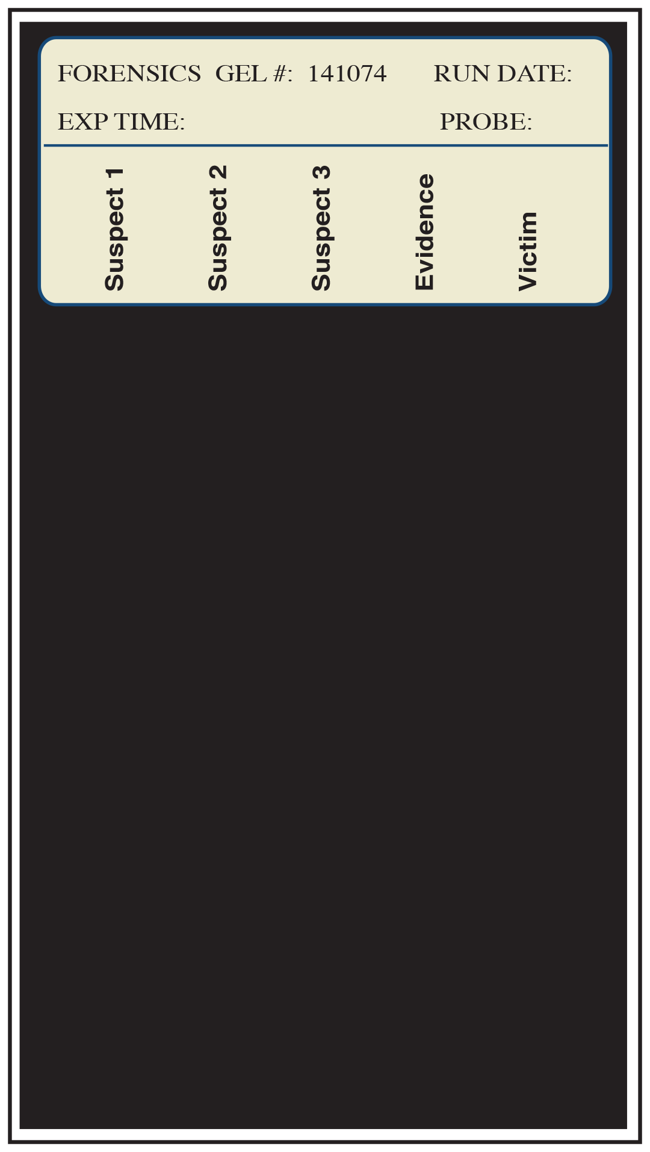
Forensic DNA Evidence
DNA fingerprints from tissue samples can be used as evidence in the same way traditional fingerprinting is used.
DNA is isolated from samples at the crime scene. Samples from the victim are also taken to eliminate them as a possible source of contamination.
DNA profiles are run and the results can be compared against a DNA database of convicted offenders.
Which DNA fingerprint from the three suspects matches that of the tissue sample submitted as evidence?

Slide 41
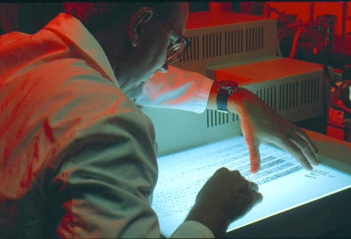
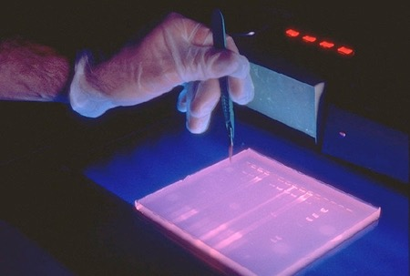
DNA Profiling
DNA profiling (DNA fingerprinting) is a technique for genetic analysis, which identifies the variations found in the DNA of every individual.
  The profile refers to the distinctive pattern of DNA restriction fragments or PCR products which is used to identify an individual.
  There are different methods of DNA profiling, each with benefits and drawbacks.
  DNA profiling does not determine a base sequence for a sample but merely sorts variations in base sequences.
  Only one in a billion (i.e. a thousand million) people are likely to have an identical DNA profile to someone else, making DNA profiling a useful tool for forensic investigations and
  paternity analysis.
CDC
CDC

Slide 42
Study Questions
Why is every genome unique, and why do even identical twins have differences in DNA expression?
What is meant by DNA Profile? How are they made? Why do we only use a small number of sequences to make them?
What is a STR? What makes them suitable for use in DNA profiling?
Describe the principles involved in gel electrophoresis
Why do we use PCR?

Slide 43
Study Questions
Illustrate the PCR process to explain why the entire target sequence is not copied until 3 cycles are complete
Why is TAQ-Polymerase the only polymerase that can be used in PCR?
What is recombinant DNA technology?
Explain why sticky ends are important when recombining DNA fragments
Describe the applications of recombinant DNA technology
Illustrate the process followed in making recombinant insulin

Slide 44
Study Questions
How could recombinant DNA technology be used to treat Tay Sachs diesease?
What is involved in gene therapy and which conditions are we closest to treating with it?
Describe how stem cell therapy is used to treat conditions such as Alzheimer's, Parkinsons, and paralysis due to spinal trauma
How could gene therapy AND stem cell therapy be combined to produce an effective treatment?
Outline some of the concerns held around the context of genetic engineering.

